Slide 1
Computer Organization
2015 - 2016

Slide 2
The Processor 1

Slide 3
Introduction
The implementation of the processor determines both the clock cycle time and the number of clock cycles per instruction (CPI)
We will be examining an implementation that includes a subset of the core MIPS instruction set:
The memory-reference instructions: lw, sw
The arithmetic-logical instructions: add, sub, and, or, slt
The control flow (branch and jump) instructions: beq, j

Slide 4
Introduction (cont.)
A simple implementation that uses a single long clock cycle for every instruction will be shown
Every instruction begins execution on one clock edge and completes execution on the next clock edge
clock

Slide 5
MIPS Summary

Slide 6
MIPS Summary (cont.)
Instruction | Format | op | funct | Instruction | Format | op | funct
add | R | 0₁₀ | 32₁₀ | lw | I | 35
addi | I | 8 |  | nor | R | 0 | 39
and | R | 0 | 36 | or | R | 0 | 37
andi | I | 12 |  | ori | I | 13
beq | I | 4 |  | sb | I | 40
bne | I | 5 |  | sh | I | 41
j | J | 2 |  | sll | R | 0 | 0
jal | J | 3 |  | slt | R | 0 | 42
jr | R | 0 | 8 | slti | I | 10
lb | I | 32 |  | srl | R | 0 | 2
lh | I | 33 |  | sub | R | 0 | 34
lui | I | 15 |  | sw | I | 43

Slide 7
MIPS Summary (cont.)
MIPS Registers
Name | Register number (decimal) | Usage | Preserve on call?
$zero | 0 | the constant value 0 | n.a.
$at | 1 | reserved for the assembler | n.a.
$v0-$v1 | 2-3 | procedure return values and expression evaluation | no
$a0-$a3 | 4-7 | procedure arguments (parameters) | no
$t0-$t7 | 8-15 | temporary registers | no
$s0-$s7 | 16-23 | general purpose saved registers | yes
$t8-$t9 | 24-25 | more temporary registers | no
$k0-$k1 | 26-27 | reserved for the OS | n.a.
$gp | 28 | global pointer | yes
$sp | 29 | stack pointer | yes
$fp | 30 | frame pointer | yes
$ra | 31 | procedure return address | yes

Slide 8
MIPS Summary (cont.)
Simplicity and regularity
fixed size instructions
small number of instruction formats
opcode always the first 6 bits
Smaller is faster
limited instruction set
limited number of registers in register file
limited number of addressing modes

Slide 9
MIPS Summary (cont.)
Immediate addressing: the operand is a constant within the instruction
addi $s1, $s2, 100
Register addressing: the operand is a register
add $s1, $s2, $s3
Base or Index addressing: the operand is at the memory location whose address is the sum of a register and a constant in the instruction
lw $s1, 100($s2)

Slide 10
MIPS Summary (cont.)
PC-relative addressing: the address is the sum of the current PC and a constant (multiplied by 4) in the instruction
beq $s1, $s2, 100
Pseudodirect addressing: the jump address is a constant (26 bits) in the instruction (multiplied by 4) concatenated with the upper 4 bits of the PC
j 2500

Slide 11
Clocking Methodology
There are two different types of logic elements:
elements that operate on data values (combinational), e.g., ALU
elements that contain state (sequential), e.g., memory and registers
A clocking methodology is used in synchronous systems to define when signals can be read and when they can be written
Edge-triggered – all state changes occur on a clock edge
cycle time
rising edge
falling edge

Slide 12
Clocking Methodology (cont.)
Typical execution
read contents of state elements -> send values through combinational logic -> write results to one or more state elements
The time necessary for the signals to reach state element 2 defines the length of the clock cycle
The value stored in a state element is changed only when the write control signal is sent from the control unit and a clock edge occurs

Slide 13
Clocking Methodology (cont.)
An edge-triggered methodology allows doing all of the following in the same clock cycle:
reading the contents of a register
sending the value read through some combinational logic
writing back to that register

Slide 14
Generic Implementation
Fetch / Execute Cycle:
use the program counter (PC) to supply the instruction address and fetch the instruction from memory (and update the PC)
decode the instruction (and read registers)
execute the instruction
Fetch
PC = PC+4
Exec
Decode

Slide 15
Generic Implementation (cont.)
There are some similarities across different instruction classes, e.g.,
All instruction classes, except j, use the ALU after reading the registers:
Memory-reference instructions use the ALU for an address calculation
Arithmetic-logical instructions use it for the operation execution
The branch instruction (beq) uses it for comparison

Slide 16
Generic Implementation (cont.)
After using the ALU, the actions required to complete various instruction classes differ:
A memory-reference instruction accesses the data memory either to write data for a store or read data for a load
An arithmetic-logical instruction writes the data from the ALU back into a register
A branch instruction may need to change the next instruction address based on the comparison; otherwise the PC should be incremented by 4 to get the address of the next instruction

Slide 17
Basic processor architecture
Control
Path
Data
Path
MAR
MDR
Processor
Control path is responsible for:
Instruction fetch and execution sequencing
Operand fetch
Saving results
Data path:
Contains general purpose registers
Contains ALU
Executes instructions
Memory

Slide 18
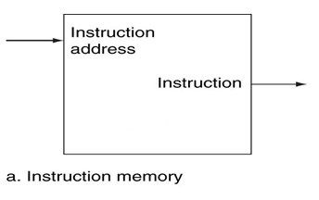
Datapath Elements (1)
Datapath element: A functional unit used to operate on or hold data within a processor
Instruction memory:
Stores and supplies the instructions of a program given an address
No read signal is needed as it is read every clock cycle
This memory is not written

Slide 19
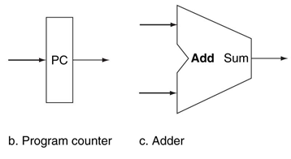
Datapath Elements (1) (cont.)
Program counter (PC):
Holds the address of the current instruction (to be fetched)
No write signal is needed as it is written every clock cycle
PC adder:
Used to increment the PC to the address of the next instruction

Slide 20
Fetching Instructions
Fetching instructions involves:
reading the instruction from the Instruction Memory
updating the PC value to be the address of the next (sequential) instruction
PC is updated every clock cycle, so it does not need an explicit write control signal just a clock signal
Reading from the Instruction Memory doesn’t need an explicit read control signal
Add
4
Instruction
Memory
PC
Read
Address
Instruction
Fetch
PC = PC+4
Exec
Decode

Slide 21
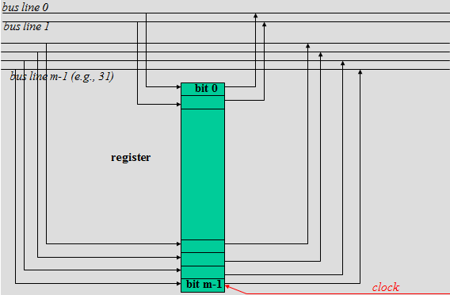
Fetching Instructions (cont.)
Thick lines (with no width indication) indicate buses of 32 bits
Add
4
Instruction
Memory
PC
Read
Address
Instruction

Slide 22
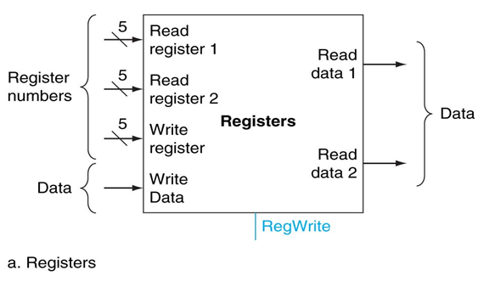
Datapath Elements (2)
Register file:
A collection of the processor 32 general-purpose registers in which any register can be read or written by specifying its number in the file
The register file contains the register state of the computer
Writes are controlled by the write control signal (RegWrite)

Slide 23
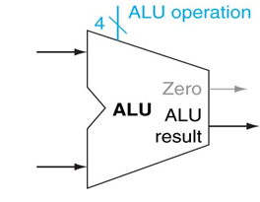
Datapath Elements (2) (cont.)
Arithmetic and logic unit:
The ALU is used to operate on the values read from the registers
It takes two 32-bit inputs and produces a 32-bit result, as well as sets a 1-bit signal if the result is zero
It is controlled by a 4-bit control signal (ALU operation)

Slide 24
Decoding Instructions
Decoding instructions involves:
sending the fetched instruction’s opcode and function field bits to the control unit then the control unit sends a 4 bit signal to ALU to determine the operation
reading two values from the Register File
Register File addresses are contained in the instruction
Control
Unit
Register
File
Read Addr 1
Read
Data 1
Instruction
Read Addr 2
Write Addr
Read
Data 2
Write Data

Slide 25
Executing R Format Operations
R format operations (add, sub, slt, and, or)
perform operation (op and funct) on values in rs and rt
store the result back into the Register File (into location rd)
31
25
20
15
10
5
0
R-type:
op
rs
rt
rd
shamt
funct

Slide 26
Executing R Format Operations (cont.)
R
e
a
d
4
A
L
U
o
p
e
r
a
t
i
o
n
r
e
g
i
s
t
e
r
1
R
e
a
d
R
e
a
d
d
a
t
a
1
A
L
U
I
n
s
t
r
u
c
t
i
o
n
r
e
g
i
s
t
e
r
2
Z
e
r
o
R
e
g
i
s
t
e
r
s
A
L
U
W
r
i
t
e
r
e
s
u
l
t
r
e
g
i
s
t
e
r
R
e
a
d
W
r
i
t
e
d
a
t
a
2
d
a
t
a
R
e
g
W
r
i
t
e

Slide 27
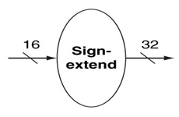
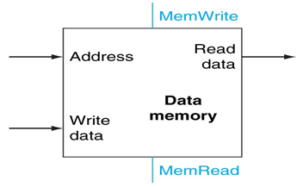
Executing Load and Store Operations
Load and store operations involves:
ALU compute memory address by adding the base register (read from the Register File during decode) to the 16-bit signed-extended offset field in the instruction
store value (read from the Register File during decode) written to the Data Memory (needs a read control signal(MemRead))
load value, read from the Data Memory, written to the Register File (needs a write control signal(MemWrite))

Slide 28
Executing Load and Store Operations (cont.)
R
e
a
d
4
A
L
U
o
p
e
r
a
t
i
o
n
r
e
g
i
s
t
e
r
1
R
e
a
d
M
e
m
W
r
i
t
e
R
e
a
d
d
a
t
a
1
I
n
s
t
r
u
c
t
i
o
n
r
e
g
i
s
t
e
r
2
Z
e
r
o
R
e
g
i
s
t
e
r
s
A
L
U
A
L
U
W
r
i
t
e
r
e
s
u
l
t
A
d
d
r
e
s
s
R
e
a
d
r
e
g
i
s
t
e
r
R
e
a
d
d
a
t
a
W
r
i
t
e
d
a
t
a
2
d
a
t
a
D
a
t
a
W
r
i
t
e
m
e
m
o
r
y
R
e
g
W
r
i
t
e
d
a
t
a
1
6
S
i
g
n
3
2
M
e
m
R
e
a
d
e
x
t
e
n
d

Slide 29
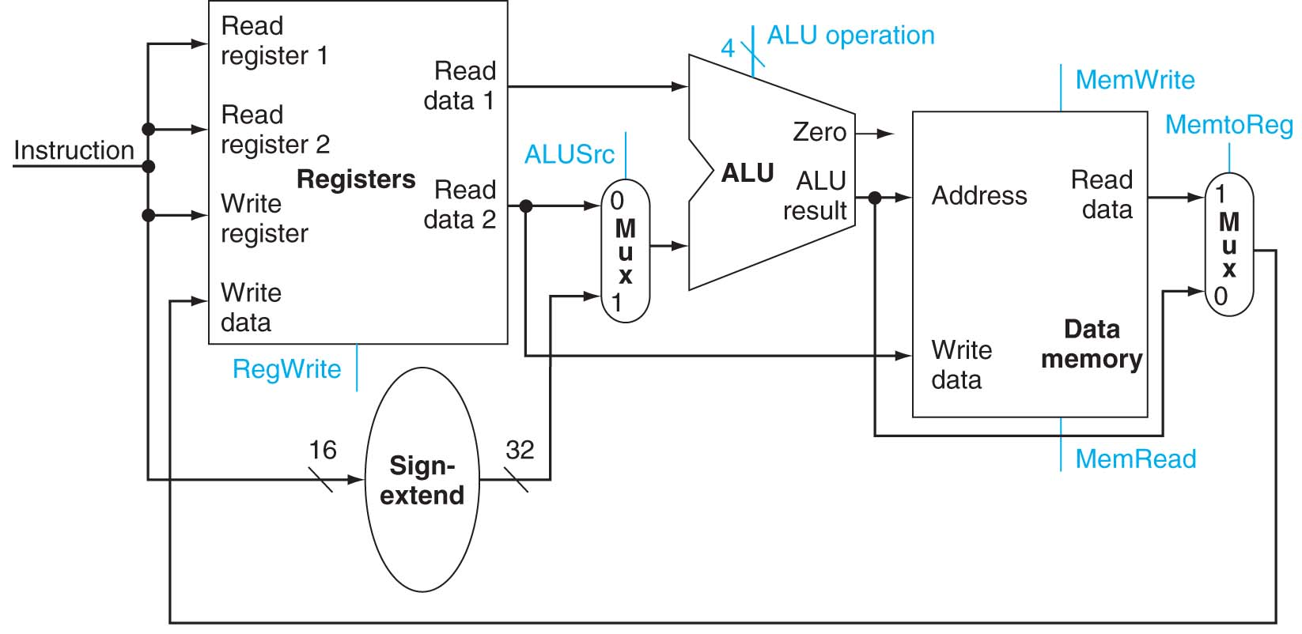
Executing R-type instructions and memory instructions:

Slide 30
add $s0, $s1, $s2
$s1
$s1 content
$s2
$s0
$s2 content
$s1 content + $s2 content
Write the result to register $s0

Slide 31
addi $s0, $s1, 20
$s1
$s1 content
$s0
16 bit represents 20
32 bit represents 20
$s1 content + 20
Write the result to register $s0

Slide 32
lw $s0, 100($s1)
Calculated memory address
$s1
$s1 content
$s0
16 bit represents 100
32 bit represents 100
memory address content
Write memory address content to register $s0

Slide 33
sw $s0, 100($s1)
Calculated memory address
$s1
$s1 content
$s0
16 bit represents 100
32 bit represents 100
Data to be written in the memory address

